Slide 2






Why Redux Toolkit?
Simplifies Redux setup
Reduces boilerplate
Built-in best practices
Core Concepts Recap
Actions, Store, Reducers
createSlice
Auto-generates actions and reducers
Handles immutability with Immer
configureStore
Simplified store setup
Built-in middleware and DevTools
Async Logic with createAsyncThunk
Handling API calls and loading states
React Integration
useSelector and useDispatch hooks
RTK Query
Data fetching and caching
Summary
Key benefits and next steps

Slide 3



rateCourse(rating) {
return
}
{ type: RATE_COURSE, rating: rating }

Slide 4






Slide 5













Slide 6


Slide 7


Slide 8












☺

Slide 9



state = {
◀
name: ‘John Doe'
role: 'author'
}
state.role = 'admin';
return state;
◀

Slide 10


state = {
◀
name: 'John Doe'
role: 'author'
}
return state = {
name: 'John Doe' role: 'admin'
}
◀
☺

Slide 11







{ ...myObj }
Object.assign
.map

Slide 12




Object.assign(target, ...sources);
Object.assign({}, state, { role: 'admin' });

Slide 13

const newState = { ...state, role: 'admin' };
const newUsers = [...state.users]

Slide 14
const user = { name: 'Cory’, address: {
state: 'California'
}
}
// Watch out, it didn't clone the nested address object! const userCopy = { ...user };
// This clones the nested address object too
const userCopy = { ...user, address: {...user.address}};

Slide 15













Slide 16

import produce from "immer" const user = {
name: "Cory", address: {
state: "California"
}
};
const userCopy = produce(user, draftState => { draftState.address.state = "New York"
})
console.log(user.address.state); // California
console.log(userCopy.address.state) // New York

Slide 17
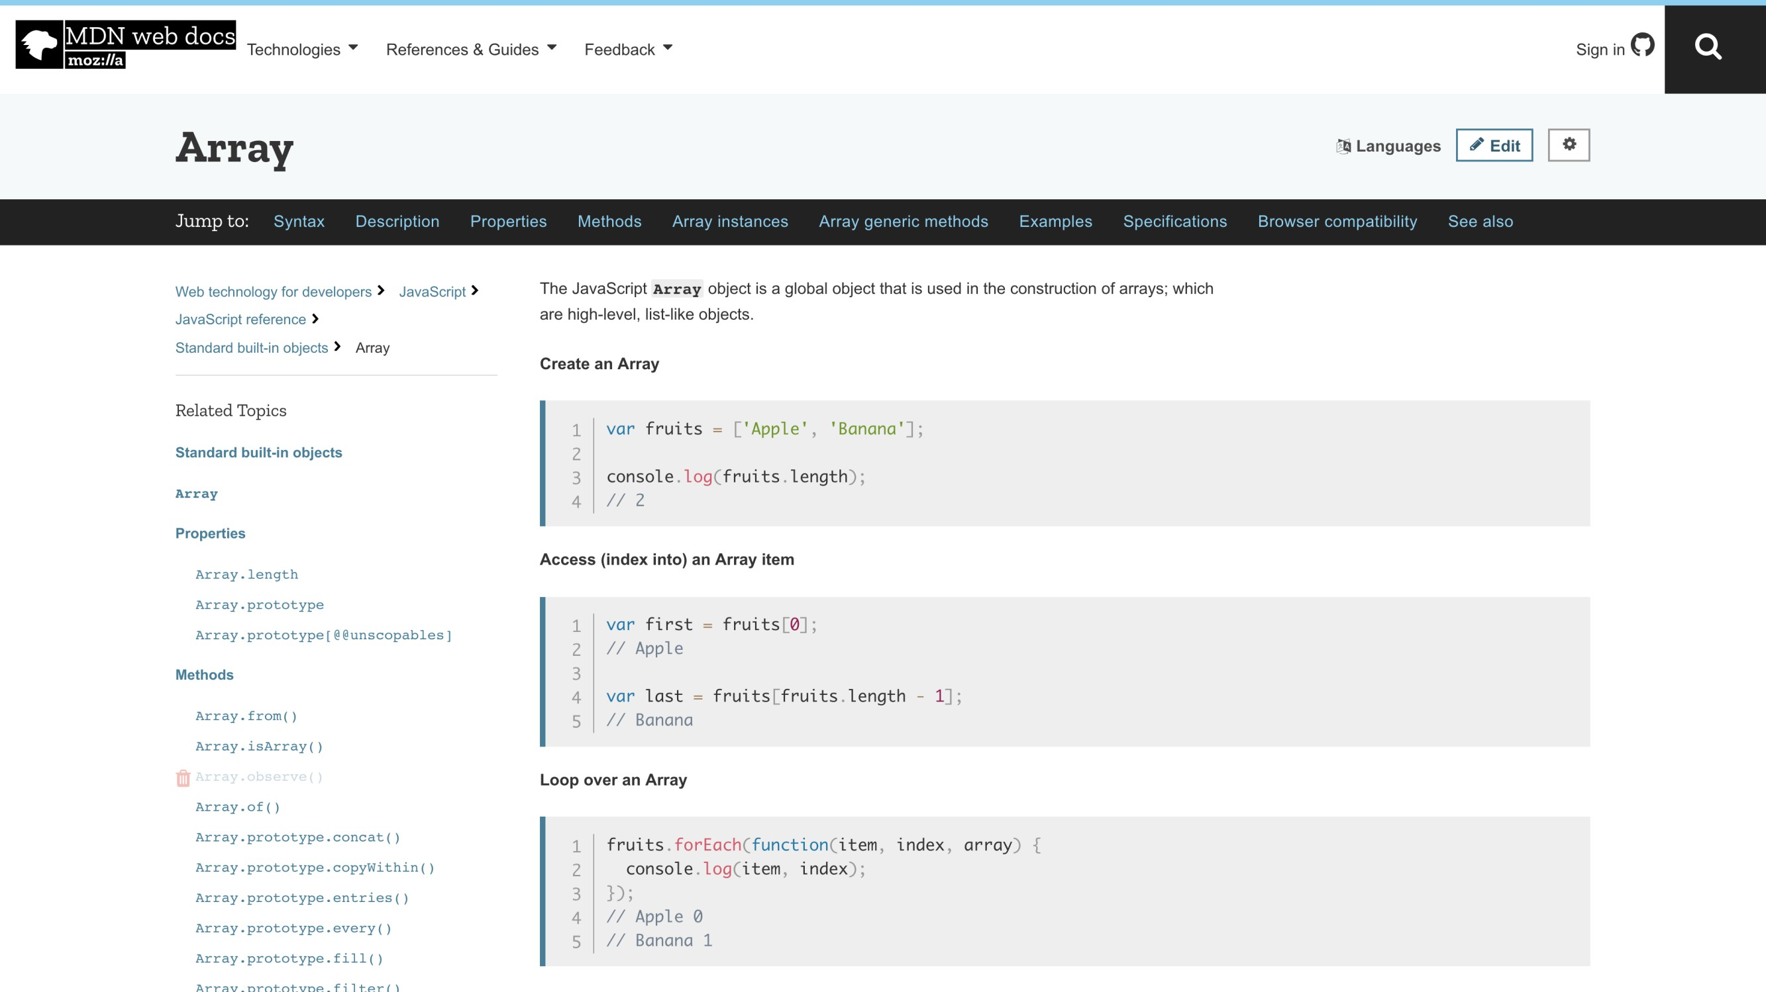

Slide 18














Slide 19













▪

Slide 20





Slide 21




▪
▪
▪

Slide 22



Slide 23




▪
▪
▪

Slide 24


state = {
name: ‘John Doe'
role: 'author’ city: ‘I Donne Know City' state: ‘Huh’ country: ‘UmmErrr’ isFunny: 'Rarely' smellsFunny: ’Often'
...
}

Slide 25
if (prevStoreState !== storeState) ...

Slide 26
▪
▪
▪

Slide 27





▪
▪
▪
▪

Slide 28


Slide 29



















Slide 30


Slide 31

function myReducer(state, action) {
// Return new state based on action passed
}

Slide 32
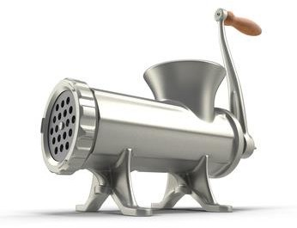


Slide 33



function myReducer(state, action) {
// Return new state based on action passed
}

Slide 34

function myReducer(state, action) { switch (action.type) {
case "INCREMENT_COUNTER":
state.counter++;
return state; default:
return state;
}
}

Slide 35
function myReducer(state, action) { switch (action.type) {
case "INCREMENT_COUNTER":
return { ...state, counter: state.counter + 1 }; default:
return state;
}
}

Slide 36


Slide 37






▪
▪
▪

Slide 39

















Slide 40






Slide 41



Slide 42












-
-
-
-
-
-
-

